Slide 1
Learning Together About
First Nations Pedagogy
Sylvia Currie, BC Campus and
June Kaminski, Kwantlen University
Canada Moodle Moot
February 13, 2013
Vancouver, BC
Notes:
This presentation demonstrates the new capabilities of PowerPoint and it is best viewed in Slide Show. These slides are designed to give you great ideas for the presentations you’ll create in PowerPoint 2010!
For more sample templates, click the File tab, and then on the New tab, click Sample Templates.

Slide 2
Overview of Session
1
2
3
Project
Background
First Nations
Pedagogy
Exploration of Topics
We wish to explore our Moodle Learning Centre with you……

Slide 3
Project background
1
How it all began……

Slide 4
Project Overview
3-phase BC Campus-funded project lead by Nicola Valley Institute of Technology and Kwantlen Polytechnic University
1) research best practices in developing and online learning for First Nations learners,
2) develop a resource website to support
3) support dialogue and sharing of ideas

Slide 5
Community Input
First Steps….

Slide 6

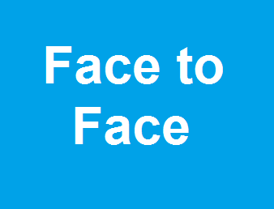

Input was Gathered from Multiple Sources
ICT Summit
ABLKC Conference Workshops
Community Circles at Kwantlen
SCOPE Forum
Facebook Group
BC Literacy Forum
Self Governance Webcast

Slide 7




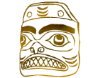
Our Goals
Collaborate to provide online content and learning strategies for First Nations students
Provide an accessible, comprehensive resource that provides direction and technique with excellent Pedagogy

Slide 8


Moodle used for Learning Centre
Open source, Constructivist, Robust, User-Friendly, Wide Choice of Activities available
Why Moodle?
Forum, Journal, Book, Wiki, Video, Glossary, Database, Quiz, Polls, etc.

Slide 9

First Nations Pedagogy
2
What does this mean?......

Slide 10


Learner Focused
The first principle is that the learning is completely

Slide 11
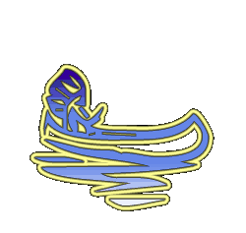
First Nations Pedagogy
Although the notion of Pedagogy is essentially Colonial or Eurocentric in origin, it can be used to draw well-deserved attention to the distinct and noteworthy ways that Pre-Colonial education was offered and engaged in.
Distinct practices used for millennia to teach both “theory” and hands-on practical knowledge were repressed and banned during Colonization, yet the methods have endured and are both unique and extremely valuable in the 21st century

Slide 12
First Nations Pedagogy
Respectful relations,
Experiential learning,
Listening well,
allowing Space,
Storytelling & making,
Quaternity,
Positionality,
Inner Fire, Gifts
Learning Spirit
Relevance,
Reciprocity,
Reflectivity,
Elders - informed,
Ecologically situated,
Creative,
Visual-auditory
self-governance philosophy
Natural world context

Slide 13
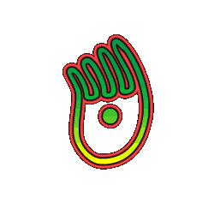
FIRST NATIONS KNOWLEDGE
- is a living process to be absorbed and understood, not possessed
- preference for experiential knowledge
- values ability to learn independently by observing, listening, participating, experimenting
- prefers multiple literacies approach
- values introspection, reflection, meditation, prayer,
- is structured by orality, language and symbolic, verbal,
and unconscious order
- is both empirical (based on experience) and normative (based on social values)‏

Slide 14
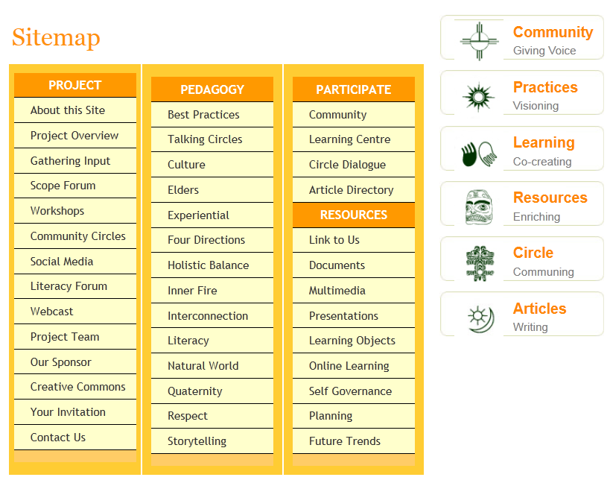

Slide 15
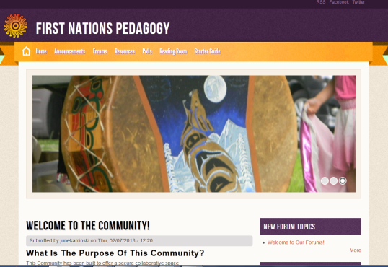
Community
Tne Community is a Drupal - based interactive content management system section, that provides a number of interactive features. To use the Community, you first need to create an account, by selecting a user name and password. Once you are a member, you can both access and add to the collection of materials, forum discussions, polls, and other resources housed within the Community area.

Slide 16
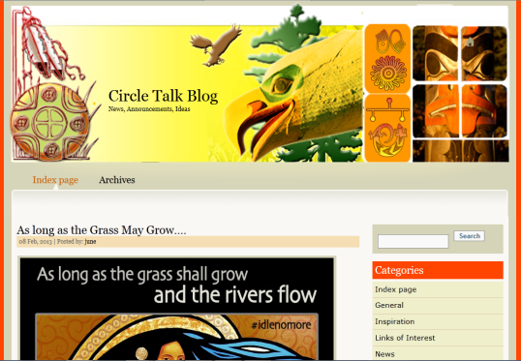
Circle Talk Blog
The Circle Talk Blog has been created using Nucleus, an open source Blog software. This area of the site has been created to easily provide updates, announcements, and share news items and links to other resources. You can also register an account in this area, if you would like to comment on posted items, or add a news item yourself.

Slide 17
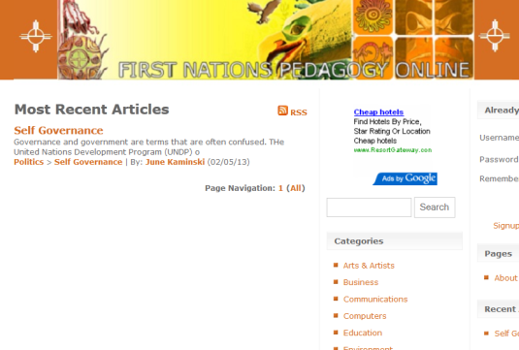
Article Directory
The Article Directory has been created using Article engine software to provide an easy venue to showcase your articles related to a variety of topics of use to Frst Nations, Inuit, and Metis people.

Slide 18
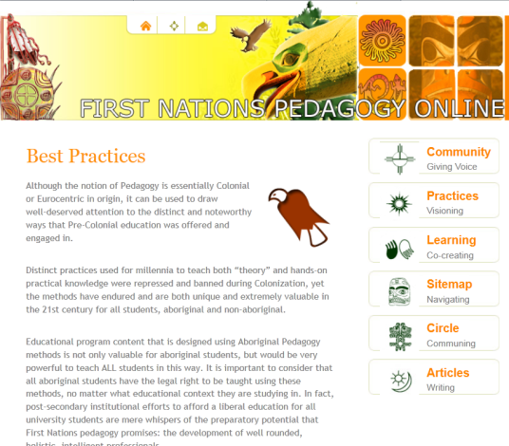
Best Practices
A series of pages that describe best practices in First Nations learning is included to inspire and be applied.
Talking Circles
Culture
Elders
Experiential
Four Directions
Holistic Balance
Inner Fire
Interconnection
Literacy
Natural World
Quaternity
Respect
Storytelling

Slide 19
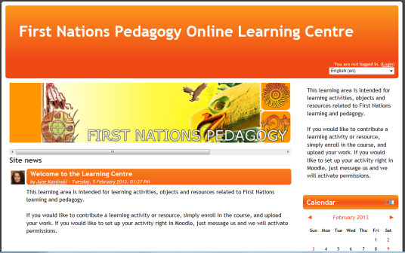
Learning Center
Tne Learning Center has been created using Moodle, an open source course management system. To use the Learning Center, you also need to create an account by selecting an user name and password (you can use the same user name and password as you used in the Community, but you will need to register these names in the Moodle interface first). This area of the site is devoted to samples of learning activities, learning objects, curriculum tools, and other educationally ready resources that you can also access and add to.

Slide 20
Exploration of Topics
3
Please help us to Plan the Learning Centre!!

Slide 21

THINK MOODLE!
What and how will people contribute?
What will people take away and how?
Who are the stakeholders? How do we build interest?
What resources exist that we can we build on?
What are design issues?

Slide 22

Closure / Next steps
Where do we go from here?
Please visit us at
http://firstnationspedagogy.ca
Share, Participate, Read, Utilize!

Slide 23





http://firstnationspedagogy.ca/contact.html
Contact Us!
What’s Your Message?

